Slide 1
CSS
MCNDHS
Ms. Eng

Slide 2
aim: How do we create borders, margins, and padding ?
Do now:
Daily Grade:
On-time/attendance/not leaving the classroom: 25%
Cellphones: 25%
Notes:25%
Classwork/Homework: 25%

Slide 3


decoration our div

Slide 4
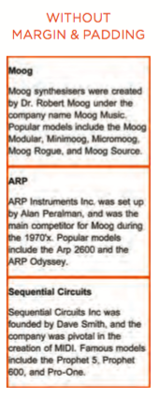
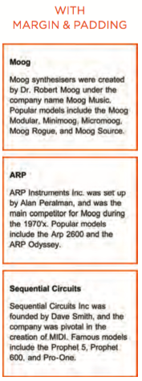
before and after

Slide 5
border
html:
<p id=“one”>woo</p>
css:
#one {
border: __px solid #______;
}

Slide 6
margin
html:
<p id=“one”>woo</p>
css:
#one {
margin: px px ;
}

Slide 7
padding
html:
<p id=“one”>woo</p>
css:
#one {
padding: px;
}

Slide 8
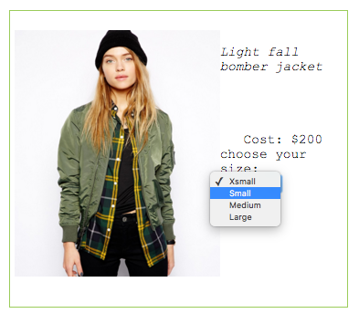

acvitiy

